Slide 1

Seeking for eEDM inside the SrOH molecule
Sr
H
O
Mingda Li
Doyle Group
2023/02/18

Slide 2
Outline
Frontier of AMO physics: Laser cooling of Large molecule
Review of laser cooling
From atom to large molecule: the Hydrogen-like structure
Seeking for eEDM inside the SrOH molecule
Insightful thinking
The existence of Electric dipole moment inside electron (eEDM)
Atom experiment to probe eEDM
Better sensitivity: molecule experiment
Evasion of Schiff’s theorem
Potential future for this area
Outlook of SrOH: Dark matter measurement

Slide 3
Frontier of AMO physics: Laser cooling of Large molecule

Slide 4
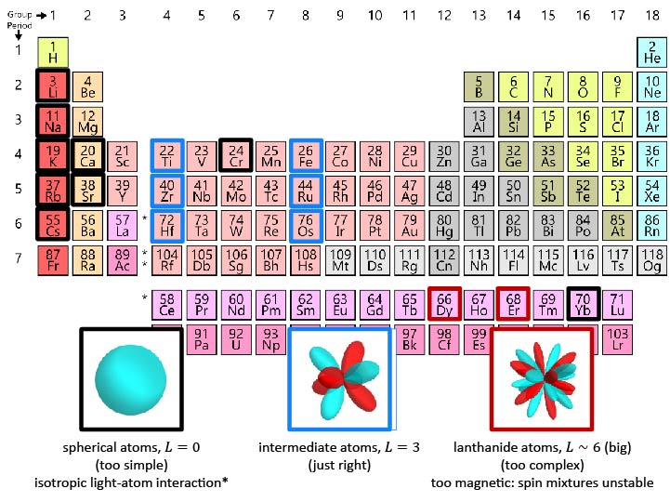
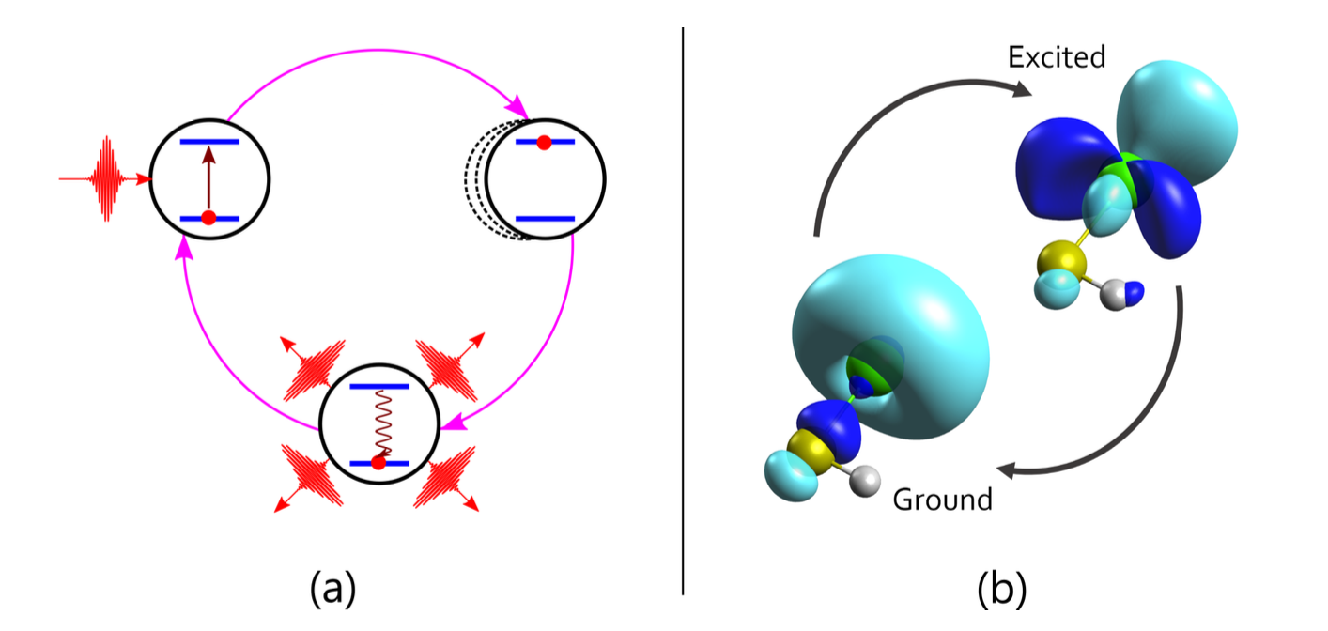
Review of laser cooling
Optical cycling!

Slide 5
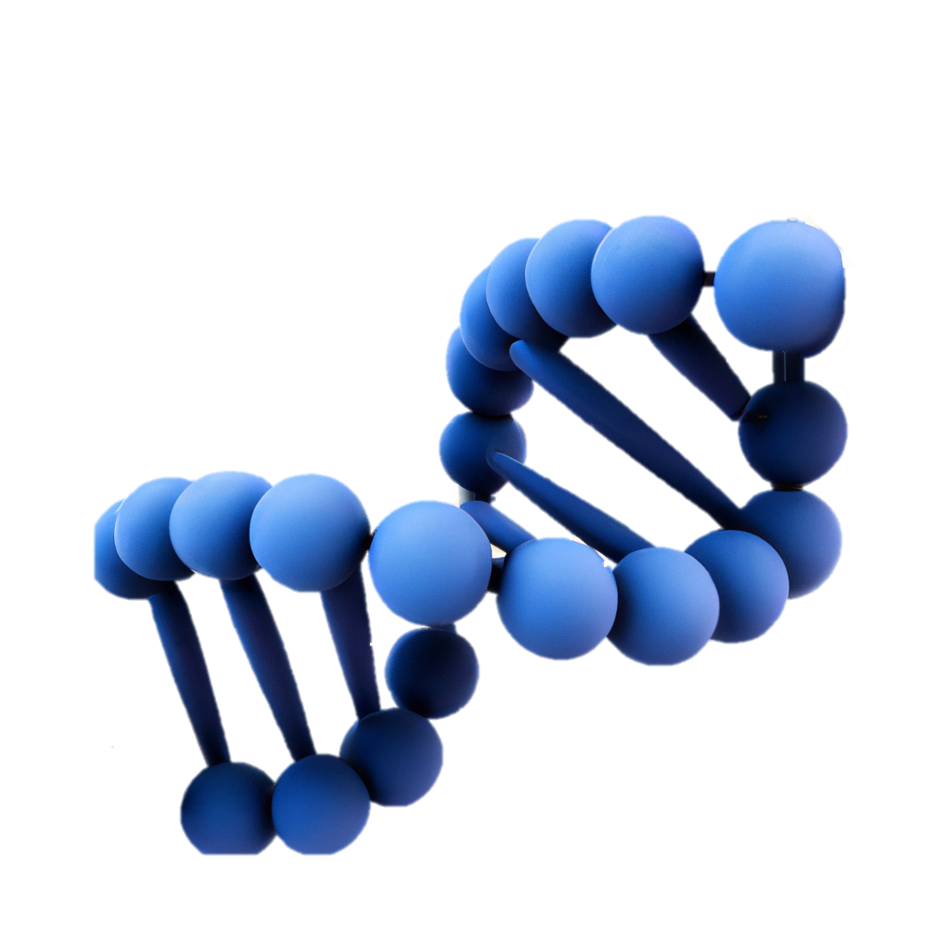


From atom to large molecule
⁺
⁻
$$H$$
$$Ca$$
$$F$$
$$Ca$$
$$O$$
$$Rb$$
$$Sr^{+}$$
$$Sr$$
$$Sr$$
$$O$$
$$H$$
$$O$$
Why we interest in Hydrogen-like structure?
Good quantum number
Why specific M-OH?
Diagonal FCFs (“Selection rule”)

Slide 6
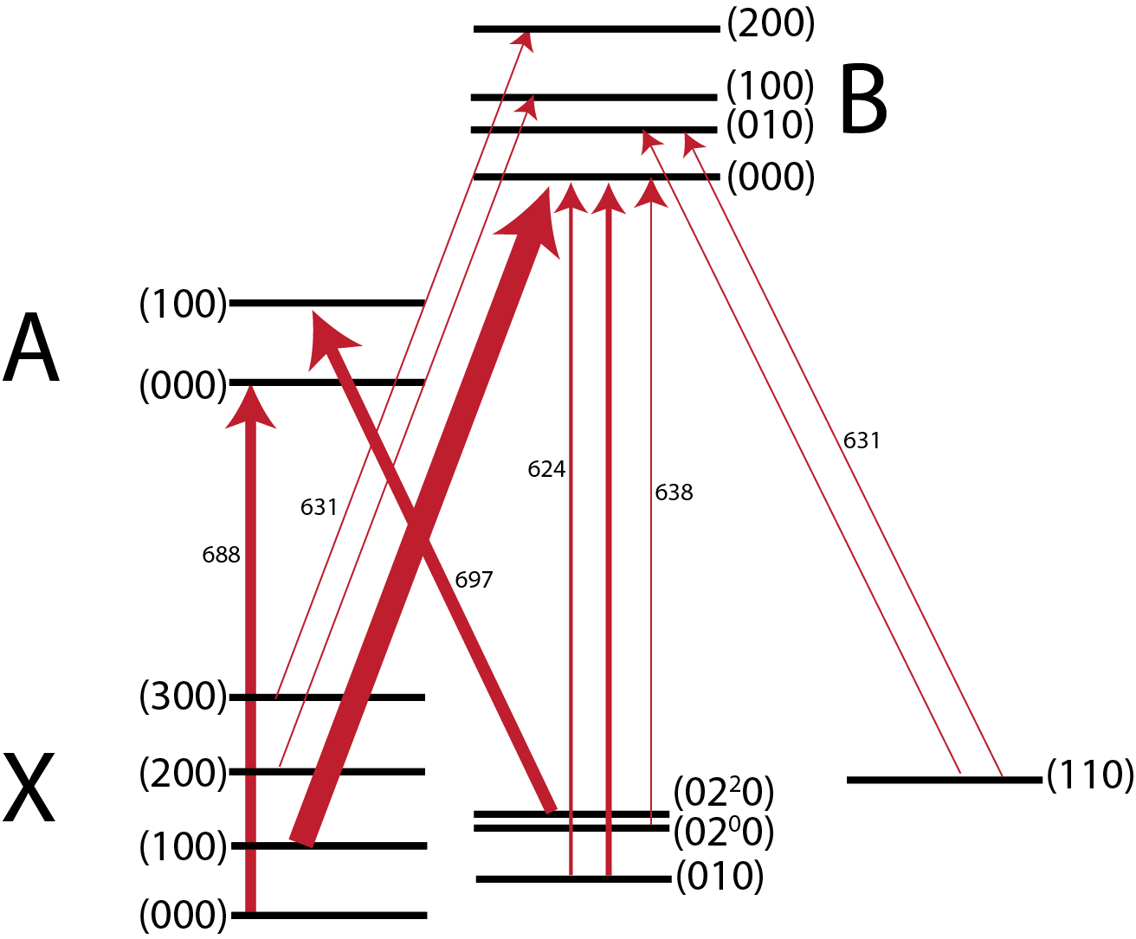
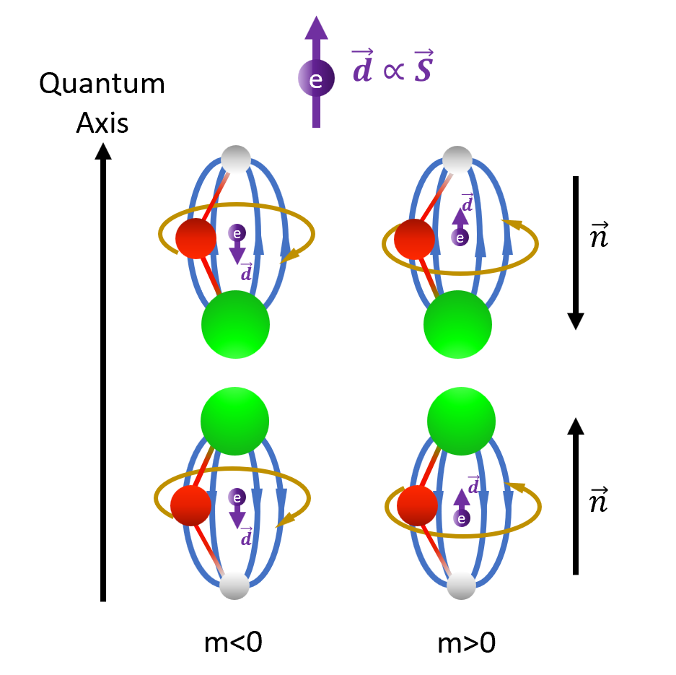
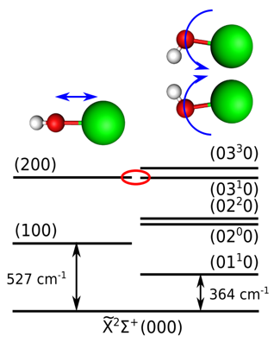
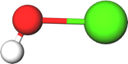

Why we want to understand SrOH?
Dark matter
Stretch+bend
EDM measurement
Sr-O stretch
Sr-O-H bend
Kozyryev, I., et al. (2021). Physical Review A 103(4).
Hutzler, N. R. (2020). Quantum Science and Technology 5(4): 044011.
The pain point is actually what is wonderful!

Slide 7
Seeking for eEDM inside the SrOH molecule

Slide 8


Consensus
General agreement: the Sun rises from the east.
But what if time reversed?
Time reverse
Thank you, DALL·E!
(Recognized by PowerPoint as traffic label….)
Notes:
Actually the Sun will still be raised up in the East direction!

Slide 9
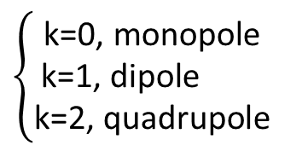


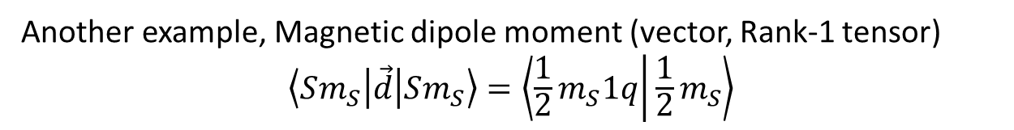

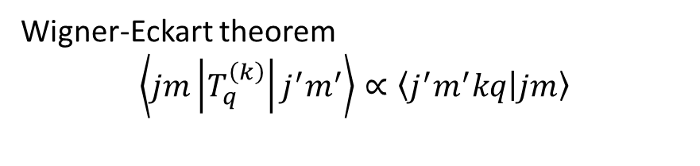
Why “possible” that electron has an Electric Dipole Moment?
Spin-1/2 particle: Charge(Monopole), EDM and MDM (dipole)
Wigner-Eckart theorem
$$\left\langle jm\left|T_{q}^{\left(k\right)}\right|j^{′}m^{′}\right\rangle ∝\left\langle j^{′}m^{′}kq | jm\right\rangle$$
$$\left\{\begin{aligned}\text{k}\text{=0, }\text{monopole} \\ \text{k}\text{=1, }\text{dipole} \\ \text{k}\text{=2, }\text{quadrupole} \end{aligned}\right.$$
$$\vec{S}$$
For example, Charge (monopole, rank-1 tensor), k=1
$$\left\langle Sm_{S}\left|\vec{μ}\right|Sm_{S}\right\rangle ∝\left\langle \frac{1}{2}m_{S}1q | \frac{1}{2}m_{S}\right\rangle$$
Another example, Magnetic dipole moment (vector, Rank-1 tensor)
$$\left\langle Sm_{S}\left|\vec{d}\right|Sm_{S}\right\rangle =\left\langle \frac{1}{2}m_{S}1q | \frac{1}{2}m_{S}\right\rangle$$
But no quadrupole for spin-1/2 particle
$$\left\langle Sm_{S}\left|\hat{Q}\right|Sm_{S}\right\rangle =\left\langle \frac{1}{2}m_{S}2q | \frac{1}{2}m_{S}\right\rangle$$

Slide 10
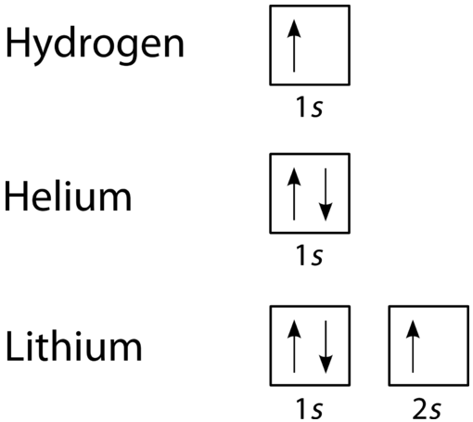
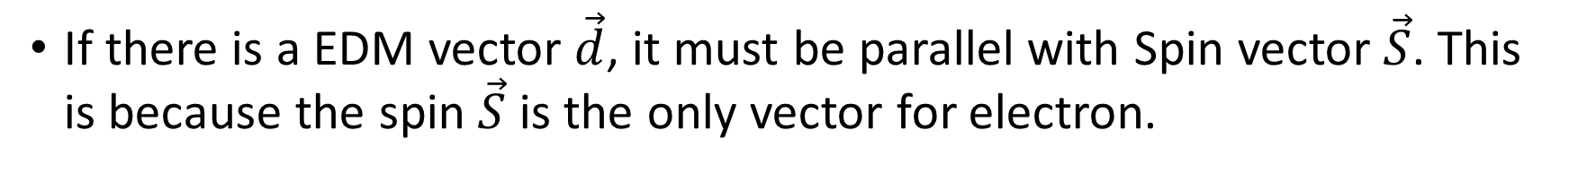
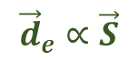
Why “possible” that electron has an Electric Dipole Moment?
If there is a EDM vector $\vec{d}$, it must be parallel with Spin vector $\vec{S}$. This is because the spin $\vec{S}$ is the only vector for electron.
Why?
$${\vec{d}}_{e}∝\vec{S}$$
Pauli exclusion principle: if there is another vector, there can be 4 electrons in 1s orbit.
Notes:
Transition to next page: What is the physics meaning of eEDM?

Slide 11
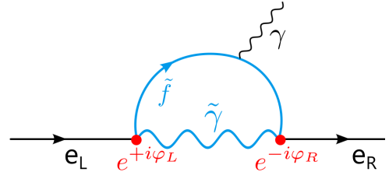
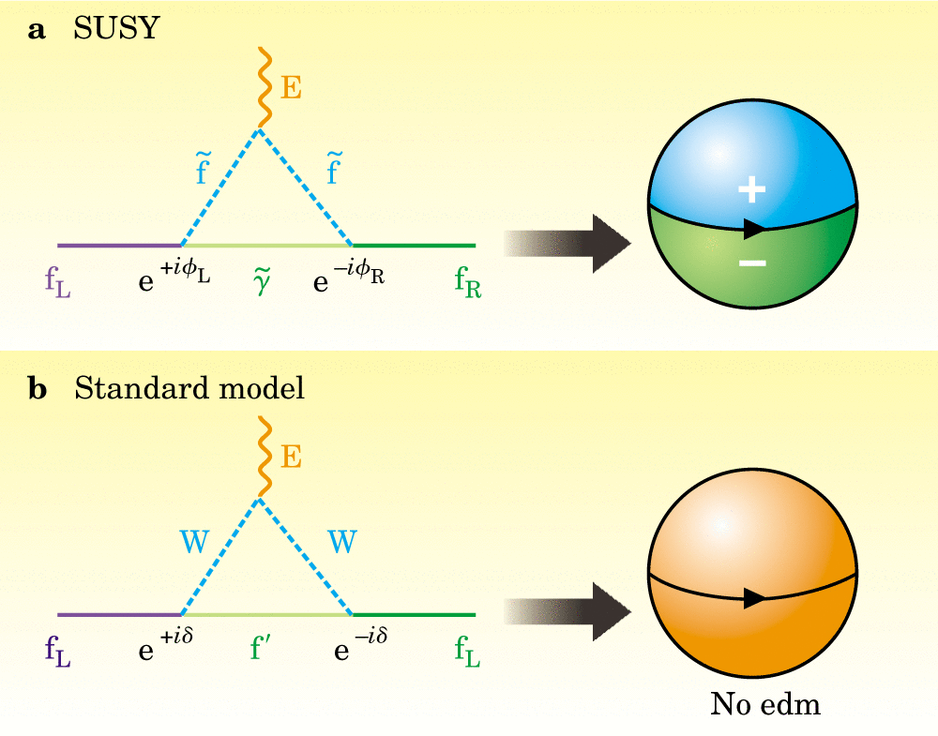
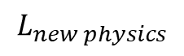
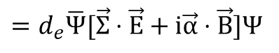
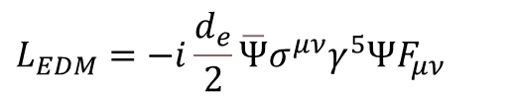

Probing TeV physics using meV platform
$$L_{new physics}$$
New Physics SUSY, etc.
$$L_{EDM}=−i\frac{d_{e}}{2}\overline{Ψ}σ^{μν}γ^{5}ΨF_{μν}$$
Effective Interaction
in Low Energy
$$=d_{e}\overline{Ψ}[\vec{Σ}⋅\vec{E}+i\vec{α}⋅\vec{B}]Ψ$$
AMO Observables
doi:10.1063/1.1595052
$$H_{EDM}=(d_{e} \vec{S})⋅\vec{E}$$
Augenbraun, B. L. (2021). Methods for Direct Laser Cooling of Polyatomic Molecules.
Notes:
Supersymmetry (SUSY) is a theoretical framework that suggests that every particle in the Standard Model of particle physics has a "superpartner" particle with different spin.
This is to explain Higgs mass.

Slide 12
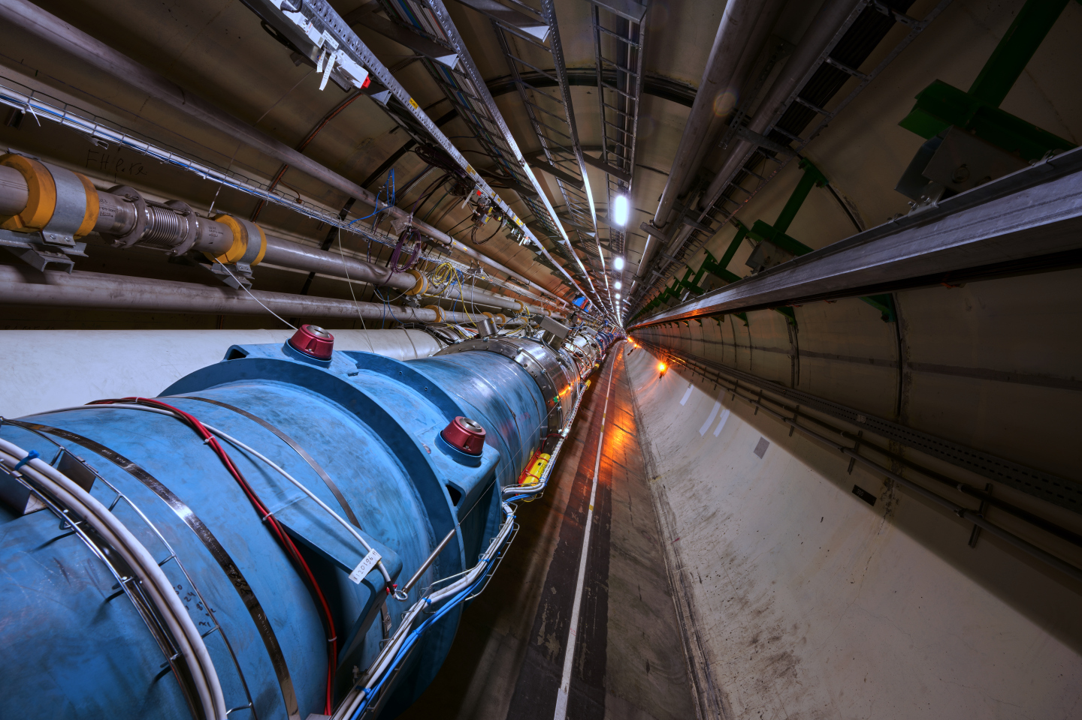
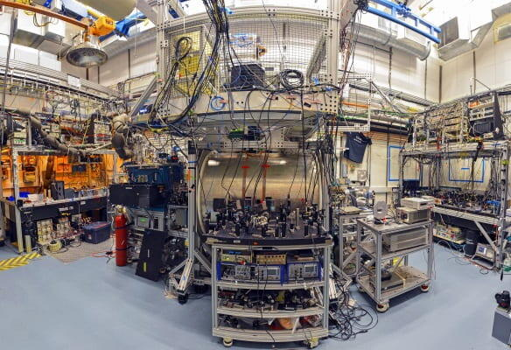
Compare with High energy experiment
Large Hadron Collider
Molecule EDM experiment
High energy but with more noise
Low energy but with better sensitivity

Slide 13
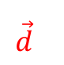
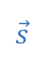
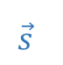
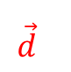
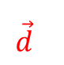

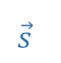
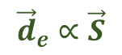
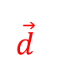


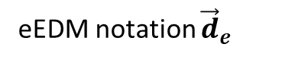
What is the special of eEDM?
Consider normal EDM v.s. Spin
$$\vec{d}$$
+
$$\vec{s}$$
$$\vec{d}$$
+
$$\vec{s}$$
$$\vec{d}$$
-
$$\vec{s}$$
$$\vec{d}$$
+
$$\vec{s}$$
P reversal
C reversal
-
-
+
-
T reversal
$${\vec{d}}_{e}∝\vec{S}$$
$$\vec{d}$$
+
$$\vec{s}$$
eEDM notation ${\vec{d}}_{e}$
-
Notes:
Transition to next page: What is the physics meaning of eEDM?

Slide 14
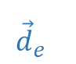
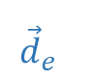
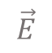


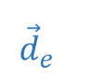
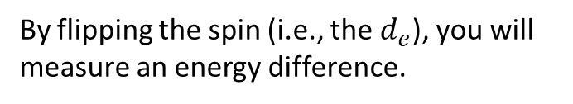
How to measure eEDM?
Consider normal EDM v.s. eEDM
$$\vec{d}$$
+
$${\vec{d}}_{e}$$
$$\vec{d}$$
+
$${\vec{d}}_{e}$$
$$\vec{d}$$
-
$${\vec{d}}_{e}$$
$$\vec{d}$$
+
$${\vec{d}}_{e}$$
P reversal
C reversal
-
-
+
-
$$\vec{E}$$
T reversal
By flipping the spin (i.e., the $d_{e}$), you will measure an energy difference.
$$\vec{d}$$
+
$${\vec{d}}_{e}$$
$$H_{+}=dE+d_{e}E ⇒ H_{−}=dE−d_{e}E$$
$$ΔH=H_{+}−H_{−}=2d_{e}E$$
-
Notes:
Transition to next page: What is the physics meaning of eEDM?

Slide 15
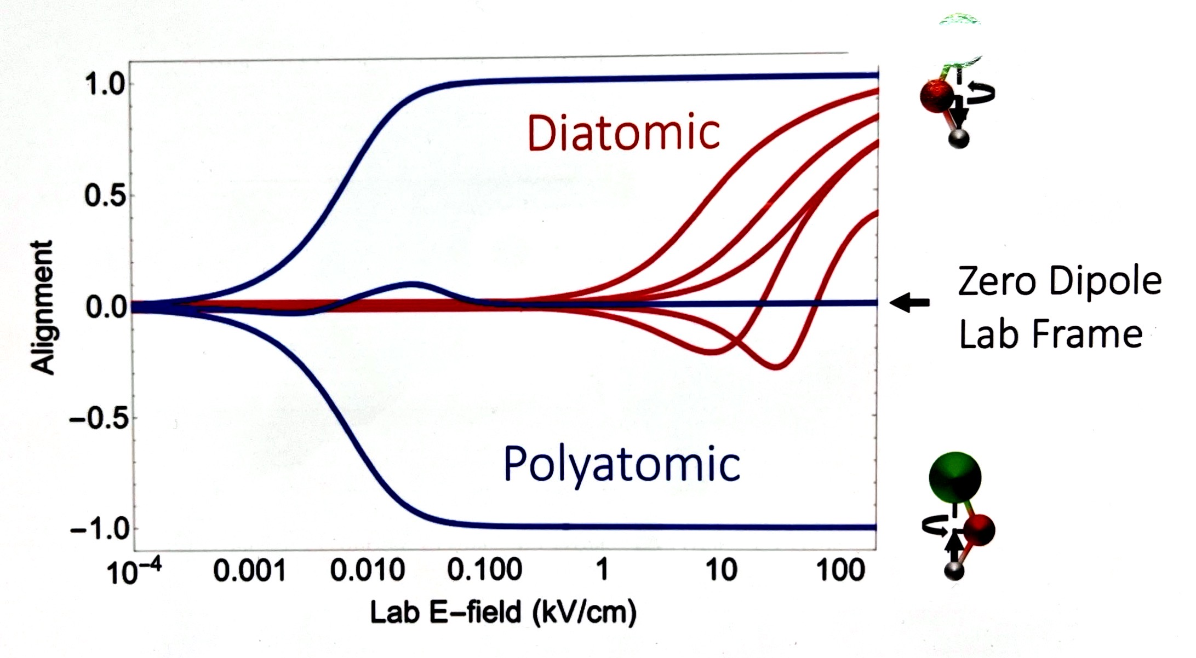
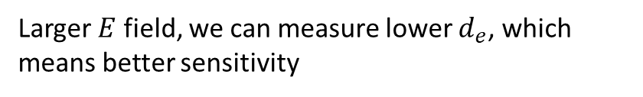
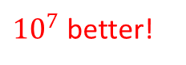
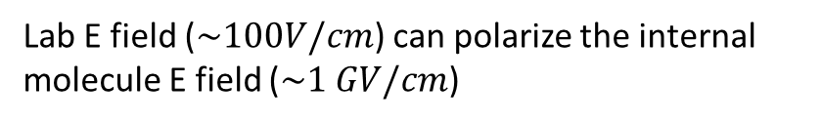
Why molecule? Better sensitivity!
$$ΔH=2d_{e}E$$
But how about the molecule E field alignment?
Larger $E$ field, we can measure lower $d_{e}$, which means better sensitivity
Quantum Axis
E field
$$\vec{d}$$
e
$$\vec{d}$$
e
m<0
m>0
Lab E field ($\sim 100V/cm$) can polarize the internal molecule E field ($\sim 1 GV/cm$)
${10}^{7}$ better!

Slide 16
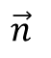
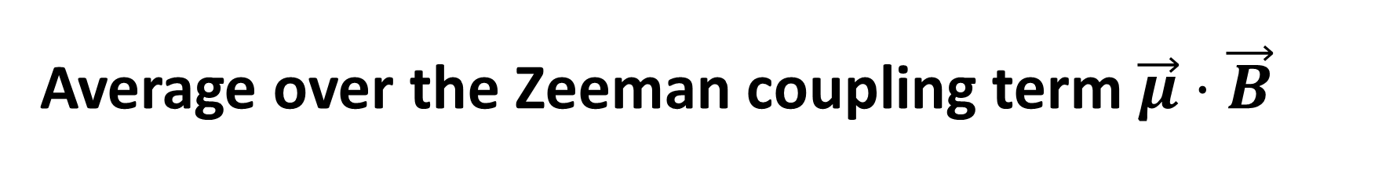

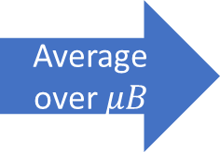
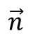
Average over the Zeeman coupling term $\vec{μ}⋅\vec{B}$
Full Hamiltonian,
$$H=g\vec{J}⋅\vec{B}+d_{e}\vec{J}⋅{\vec{E}}_{molecule}+\vec{d}⋅{\vec{E}}_{lab}$$
Quantum Axis
$$\vec{d}∝\vec{S}$$
e
E field
Quantum Axis
$$\vec{d}$$
E field
e
e
$$\vec{n}$$
$$\vec{d}$$
$$\vec{d}$$
Average over $μB$
e
$$\vec{d}$$
e
m<0
m>0
$$\vec{d}$$
$$\vec{n}$$
e
$$\vec{d}$$
e
m<0
m>0

Slide 17
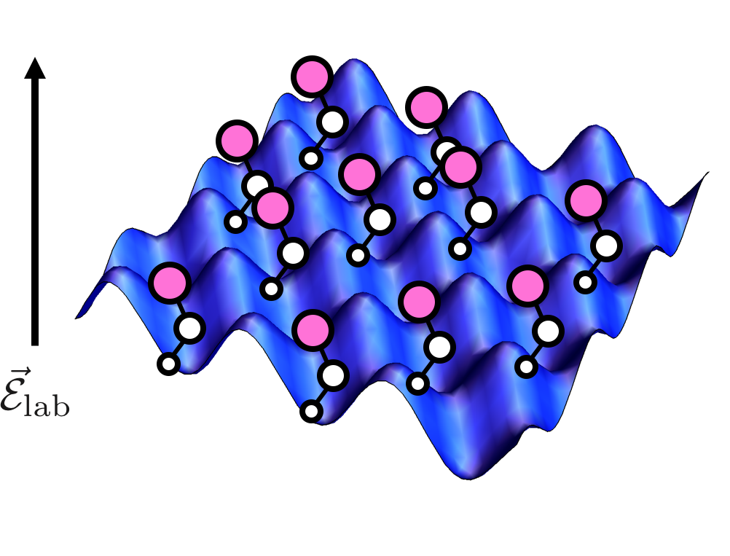
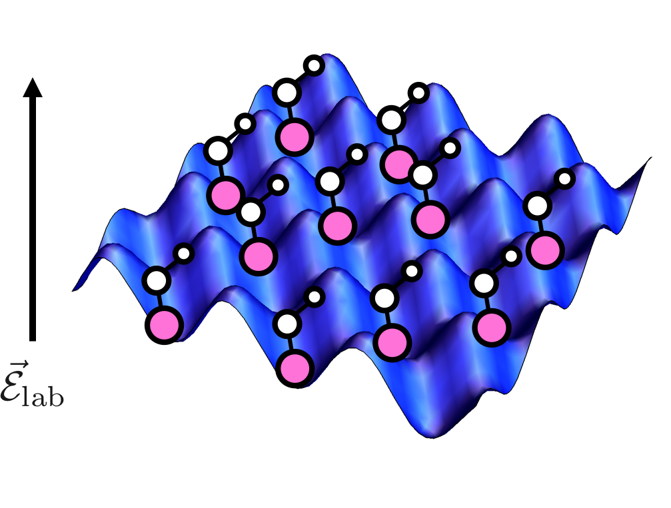
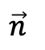
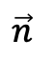
Molecule in lattice
$$\vec{d}$$
$$\vec{d}$$
e
e
$$\vec{n}$$
e
$$\vec{n}$$
$$\vec{d}$$
$$\vec{d}$$
e
m<0
m>0
m<0
m>0

Slide 18

Revisit the consensus
General agreement: the Sun rises from the east.
Time reverse
Because this is axial-vector coupling with axial-vector
Full Hamiltonian,
$$H=g\vec{J}⋅\vec{B}+d_{e}\vec{J}⋅{\vec{E}}_{molecule}+\vec{d}⋅{\vec{E}}_{lab}$$
Notes:
Actually the Sun will still be raised up in the East direction!

Slide 19
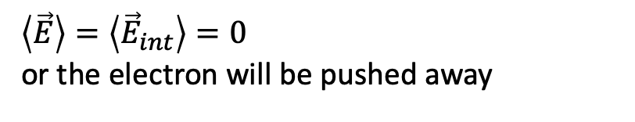
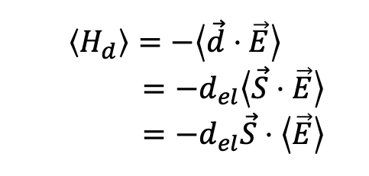
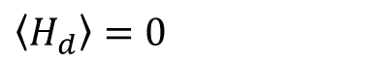
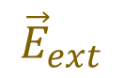

Wait… One thing wrong: Schiff’s theorem
e⁻
$$\left\langle H_{d}\right\rangle =−\left\langle \vec{d}⋅\vec{E}\right\rangle$$
$$=−d_{el}\left\langle \vec{S}⋅\vec{E}\right\rangle$$
$$=−d_{el}\vec{S}⋅\left\langle \vec{E}\right\rangle$$
+
$\left\langle \vec{E}\right\rangle =\left\langle {\vec{E}}_{int}\right\rangle =0$
or the electron will be pushed away
$${\vec{E}}_{ext}$$
e⁻
$$\left\langle H_{d}\right\rangle =0$$
+
$$\left\langle \vec{E}\right\rangle =\left\langle {\vec{E}}_{int}+{\vec{E}}_{ext}\right\rangle =0$$

Slide 20






Oh, Schiff’s theorem is wrong
$${\vec{E}}_{ext}$$
We can’t measure electron EDM! Is that true?
e⁻
+
$$\left\langle H_{d}\right\rangle =−\left\langle \vec{d}⋅\vec{E}\right\rangle$$
$$=−\left\langle d_{el}\vec{S}⋅\vec{E}\right\rangle$$
$$≠−d_{el}\vec{S}⋅\left\langle \vec{E}\right\rangle$$
=0
$$\left\langle \vec{E}\right\rangle =\left\langle {\vec{E}}_{int}+{\vec{E}}_{ext}\right\rangle =0$$
$d_{el}\vec{S}⋅\vec{E}=d_{el}\vec{S}({\vec{r}}_{el})⋅\vec{E}({\vec{r}}_{el})$ not separatable!
When S near nuclear, there will be a Lorentz contraction of dipole moment.
Relativistic effect sensitivity $R\sim Z^{3}$

Slide 21

Future of EDM: 1. RaOH
Sensitivity $R\sim Z^{3}$
Molecule | $E_{eff}$ [GV/cm] | # in trap for ACME II | Unsolved challenges
BeOH | 0.005 | $$400×{10}^{6}$$ | -
MgOH | 0.07 | $2×{10}^{6}$ | -
CaOH | 0.30 | $100,000$ | -
--- | 1 | $10,000$ | --
SrOH | 2.2 | $2,000$ | We don’t think so
BaOH | 6.8 | $200$ | A, B are strongly perturbed by metastable $Δ$ state
YbOH | 23.6 | 20 | Repumping f states, a lot of remaining spectroscopy
RaOH | 56.9 | 3 | Hard to make, no existing spectroscopy

Slide 22

Future of EDM: 2. SrOCH3
About the doublet: Easier to polarize
About the lifetime: larger molecule can be longer
SrF: Electronic excited state
SrOH: Vibrational excited state, $\sim s$
SrOCH3: True ground state, $\sim ∞$

Slide 23
Outlook of SrOH

Slide 24










Dark matter measurement
$$φ_{DM}$$
$$E (bending)$$
$E$ (stretching)
Trap
Probe
Sensitivity can be enhanced with spin squeezing in a cavity
Kozyryev, I., et al. (2021). "Enhanced sensitivity to ultralight bosonic dark matter in the spectra of the linear radical SrOH." Physical Review A 103(4).

Slide 25
Thanks for attention!
Questions?

